Slide 1
Apache Hadoop Meets Cybersecurity
Deploying an Enterprise Data Hub for Cybersecurity

Slide 2
Challenges with traditional threat detection
Security Operations
Data left out of process
Expensive to scale systems
Proprietary tooling makes difficult to implement new
Security Analysts
Out of the box analytics
Signature based is yesterdays threat
Can’t do advanced analytics
Security Responders
Data takes weeks to retrieve
Raw and historic data offline
Reactive instead of predictive

Slide 3

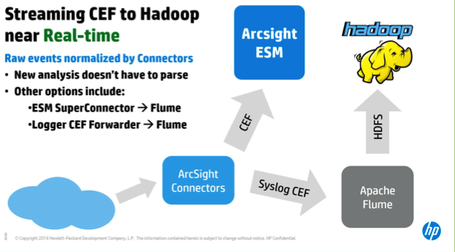


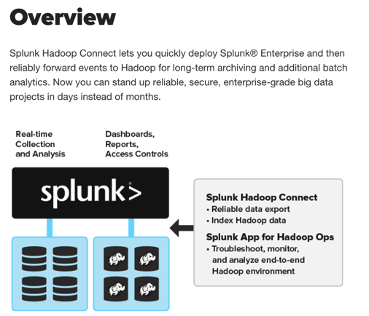
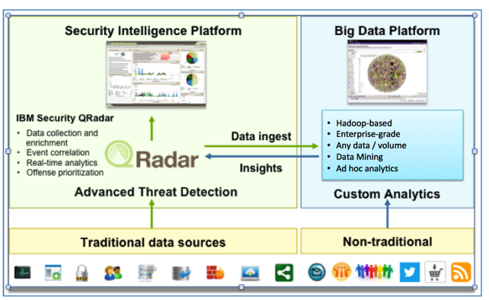
The shift to Apache Hadoop has already begun…
Notes:
HP ArcSight: https://www.protect724.hpe.com/docs/DOC-12978
Splunk (Hadoop Connect): http://www.splunk.com/en_us/solutions/solution-areas/big-data/splunk-hadoop-connect.html
Export events from Splunk to Hadoop
Browser directories and files in Hadoop
Index data from Splunk in Hadoop for secure search, visualization, analytics
Qradar: https://www.ibm.com/.../Integrating_QRadar_with_Hadoop.pdf

Slide 4
Powering a New Breed of Cybersecurity
Machine Learning
Advanced Statistics
Analytics
(Basic > Advanced)
SQL
Correlations
SIEM
(TBs)
Search
40
20
10
5
Time
(Months)
1
Aggregated
Events
User
Data
Raw
System Logs
Network
Flows/ DNS
Full
Packet
Capture
Video,
Text, Images
Data Types
(MBs>PBs)
Notes:
Traditional SIEMs…
Y-axis: Detect known threats using search and correlation based techniques. They are not meant for querying/ or advanced analytics.
X-axis: The data that you store in the SIEM needs to be structured and limited in volume. High large, high volume data sources are not being stored or processed.
Z-axis: The volume of information is limited. SIEMs only store 90 to 120 days worth of data.

Slide 5
Powering a New Breed of Cybersecurity
Apache Hadoop Based Applications
(PB)
Machine Learning
Advanced Statistics
Analytics
(Basic > Advanced)
SQL
Correlations
SIEM
(TBs)
Search
40
20
10
5
Time
(Months)
1
Aggregated
Events
User
Data
Raw
System Logs
Network
Flows/ DNS
Full
Packet
Capture
Video,
Text, Images
Data Types
(MBs>PBs)
Notes:
Cloudera’s EDH:
Y-axis: Allows a wide range of access to the data depending on analytics technique. Not just a search or SQL engine.
X-axis: Any volume or type of data can be stored on the enterprise data hub.
Z-axis: Months and years worth of data can remain accessible for threat responders to access and analysts to analyze.

Slide 6
Benefits of modern threat detection
Security Operations
Keep data online forever
Process larger volumes of diverse data
Security Analysts
SQL, Statistical, Machine Learning capabilities
Advanced Persistent Threat detection
Security Responders
Make data accessible immediately
Provide raw and enriched data access

Slide 7

Cloudera’s Enterprise Data Hub for Cybersecurity
powered by Apache Hadoop
Modernize cybersecurity infrastructure
Faster advanced threat detection
Rapid threat mitigation
Cybersecurity Applications
Process
Discover
Model
Serve
Security and Administration
Unlimited Storage
Deployment Flexibility
On-Premises
Appliances
Engineered Systems
Public Cloud
Private Cloud
Hybrid Cloud
Notes:
Deploying an EDH for cybersecurity allows organization to store, process, and analyze petabytes worth of data in order to…
Modernize your existing cybersecurity infrastructure by providing a future-proofed platform for data growth and new cybersecurity applications and use cases. Whether you are building a custom system on Cloudera’s EDH, plugging in existing applications, or deploying an open source cybersecurity solution (like Intel’s Open Network Insights) Cloudera provides an interoperable data management platform that allows you to see a recurring return on your investment as needs change.
Faster advanced threat detection using behavior driven advanced analytics and powerful visual analysis across TB worth of data.
Rapid threat mitigation with instant access to comprehensive full-fidelity data.
There is a rich ecosystem of cybersecurity applications that plug directly into the Cloudera’s EDH in order to leverage the horsepower of Hadoop. We will hear about one of those partners later today.

Slide 8





































Security Analytics Solutions
Cybersecurity
Applications
Cybersecurity
Applications
Rich eco-system of ISV Applications, Managed Service solutions and Open Source Software
Open Network Insight (ONI)
Operational Tools
Data Systems
Enterprise Data Hub
System Integration
System Integration
Process
Discover
Model
Serve
Security and Administration
Unlimited Storage
Infrastructure
Notes:
Goal of the slide is to identify: Customer has a well articulated use case and neither the resources and/ or inclination to invest in security analytics development.
Cloudera partners more broadly and deeply across the Hadoop ecosystem than any other vendor. With over 1200 partners and counting, our partnerships offer:
Compatibility with your existing tools and skills
160+ certified on Cloudera 5, including all 12 of the 12 Gartner Business Intelligence Magic Quadrant leaders
Flexible deployment options
On-premises
Public, private, or hybrid cloud
Appliances and engineered systems
Partnerships you can trust
Deep engineering relationships
Comprehensive certification program

Slide 9
ONI Strategy
Core, Open Data Models
Network
Endpoint
User / Identity
Superior Technology
Silicon exploitation: performance and scalability; analysis of telemetry data
Apache Hadoop
Adjacent Use Cases
Cybersecurity
Network Operations
Fraud
User Experience Optimization
Diverse OSS Community
Community Committers
ISV Committers
GSI Committers

Slide 10
ONI Data Models accelerate community collaboration
Vendors leveraging Apache Hadoop and ONI data models will…
Accelerate use case development
Shorten sales cycles into Apache Hadoop shops
Easily integrate 3rd party threat intelligence feeds
Customers leveraging Apache Hadoop and ONI data models will…
Rapidly introduce new and multiple vendor use cases
Exchange use cases easily with peer organizations
Quickly develop unique in-house use cases

Slide 11
Solution Approach – Network Data Model
Open Data Model
Cybersecurity Analytics and Applications
Network
Flows
(nfcapd)
Parallel
Ingest
Framework
Machine
Learning
Operational
Analytics
DNS
(pcap)
Notes:
Misconfigurations, network problems you didn’t know about. Security and misconfigurations account for an enormous part of what they do. Its all fire fighting. Things are either operational or security not both.

Slide 12









Use Case: Hidden Networks and Suspicious Connects
How can I find the bad mixed in with all the good?
1
2
3
4
5
Take action
Monitor
Ignore
Deliver suspicious connections in ranked order with multiple data points such as time, traffic flow, and more.
Suspicious!
Port
143
IMAP
Port
143
IMAP
Human input helps the system evolve. Quickly eliminate false positives from the lineup.
Port
80
HTTP
Advanced
Analytics
Algorithms
Identify the needle in the haystack with patterns that provide insight into potential threats.
And make every item on the list worth your time to investigate.
Notes:
Find the needle in the haystack. Note: slideshow mode builds image in the following sequence:
1. You can see all the connections, but which are suspicious?
2. Netflow data is sent through the advanced algorithms
3. The algorithms identify the most likely candidates for further investigation
4. The suspicious connections are ranked and given to a human to analyze
5. The human determines what actions to take toward each item
6. Feedback then makes the system grow smarter and more useful

Slide 13

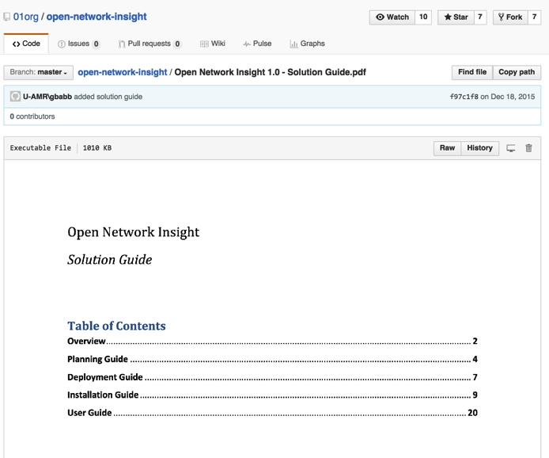
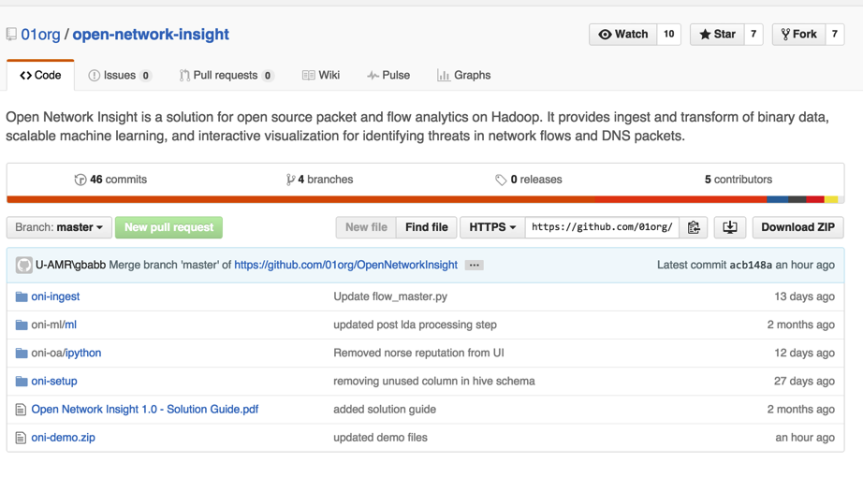

Slide 14
Our customers have already seen success.

Slide 15



Dell SecureWorks investigates ~1,000 potential security incidents and analyzes ~20,000 pieces of malicious software.
Notes:
***Use this story to highlight analyzing large volumes of security information at a lower cost per TB***
Every day Dell SecureWorks analyzes 1K security incidents and 20K pieces of malicious software. They process 20B events per day in real time.
Link to account record in SFDC (valid for Cloudera employees only): https://na6.salesforce.com/0018000000rBJSQ?srPos=0&srKp=001
Dell SecureWorks designs better defenses through complex analytics on historical security breaches.
Background: Dell SecureWorks is on deck 24 hours a day, 365 days a year, to help protect the security of its customers’ assets in real time. To meet its enormous data processing challenges, Dell SecureWorks requires leading-edge technologies for cost-effectively storing, scaling, and analyzing massive amounts of information in real time. SecureWorks processes ~20 billion events per day in real time. An event is a single transaction for a security device, such as a firewall or an intrusion prevention system (IPS), or a log event from an application or operating system.
Challenge: Each day, the SecureWorks organization investigates ~1,000 potential security incidents and analyzes ~20,000 pieces of malicious software. Leveraging this global intelligence enables SecureWorks to offer improved threat protection on behalf of its customers. To deal with the massive amounts of information it collects, SecureWorks requires highly scalable solutions for processing, storing, and analyzing big data in a cost-conscious manner. Historically, the SecureWorks organization met this need with proprietary technologies. But a few years ago, it started looking for next-generation solutions that would deliver greater scalability at lower cost, including those based on open-source software and industry standard hardware.
Solution: This search culminated in the deployment of the Dell | Cloudera Solution, comprised of Apache® Hadoop® open source software, Dell PowerEdge C servers, Force10™ switches, and services from Cloudera and Dell. Hadoop offered a highly scalable system with built-in availability, and the capability to run very-high-analytics types of activities.
Results: By migrating to the Dell | Cloudera solution, SecureWorks reduced storage costs from $17 per GB to only 21 cents per GB. The Hadoop environment paid for itself in one year. And the cost savings delivered by this solution will continue delivering substantial savings as SecureWorks doubles its business and associated data volumes every 18 months.

Slide 16

Consumer credit provider building detection models using a full year of comprehensive log and indicator data

Slide 17

US Bank leveraging user behavior analytics to detect fraud and inside user threats

Slide 18

A US national security organization identifies potentially suspicious activity across the worldwide web, and supply threat information to 700 commercial and federal organizations.
Notes:
Link to account record in SFDC (for Cloudera employees only): https://na6.salesforce.com/0018000000oqdOF?srPos=0&srKp=001
A national security organization in the US offers real-time information, warnings and guidelines that strengthen our ability to protect against cyber attacks. Background: In today’s digital world, cyber security is a serious effort. A US national security organization is tasked with identifying potentially suspicious activity across the worldwide web, and they must make that information available to 700 commercial and federal organizations.
Challenge: More data lends itself to more accurate predictions, so logically the organization has been collecting massive volumes of cyber data in order to prevent cyber attacks. But their incumbent IBM Netezza environment was hitting scalability and performance limitations.
Solution: The organization deployed a Cloudera Enterprise platform with Sherpasurfing, an open source cyber security solution created by Six3 Systems. Cloudera runs data processing, staging and storage; the Cloudera environment is integrated with Netezza which performs analytics. The system is also integrated with HP ArcSite, Tableau and Centrifuge. Hadoop components in use include Accumulo, Hive, Flume, MapReduce and Sqoop. This organization is growing their Cloudera cluster to 100 PB.
Results: Since deploying Cloudera alongside Netezza, this organization can offer real-time information and warnings to other government organizations. They can also now show rich information on major malware outbreaks and provide guidelines to strengthen organizations’ protection against cyber attacks -- this is a net new capability that resulted from their Cloudera deployment.

Slide 19

CRM provider using comprehensive log archive provides immediate availability to support investigation and mitigation

Slide 20
Thank you.

